Slide 1


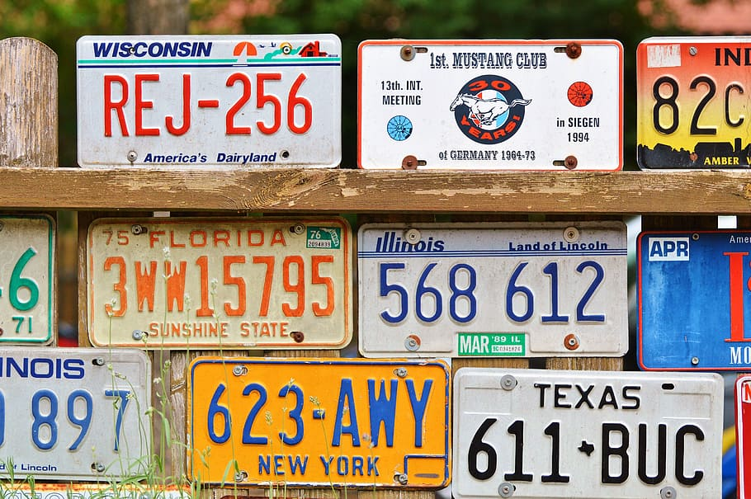
Vehicle Number Plate Detection and Recognition in Python
Mentor -: By -:
Ms. Meenakshi Maindola Adarsh Patel

Slide 2
INTRODUCTION
Vehicle Number Plate Detection and Recognition in Python involves using computer vision techniques to locate and identify license plates in images or videos. This technology can be applied for various purposes, such as automated toll collection, parking management, and law enforcement. In simpler terms, it's a way for computers to "see" license plates on vehicles and extract the information from them using Python programming.

Slide 3
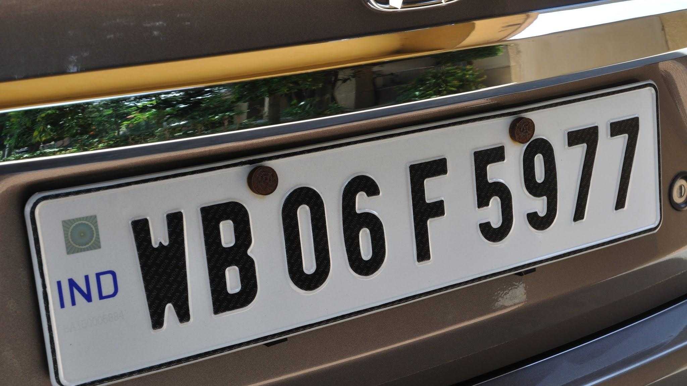
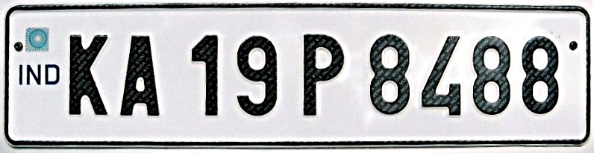
Our project uses Python, OpenCV and TensorFlow to teach computers to "see" license plates. We're applying computer vision to automatically recognize license plates on vehicles. Our step-by-step approach involves getting images ready, finding the license plate area, breaking down characters, and figuring out what's written on the plate. We're not just stopping there – our work has practical uses, like making toll collection and law enforcement more efficient. This can have a positive impact on transportation security systems.

Slide 4
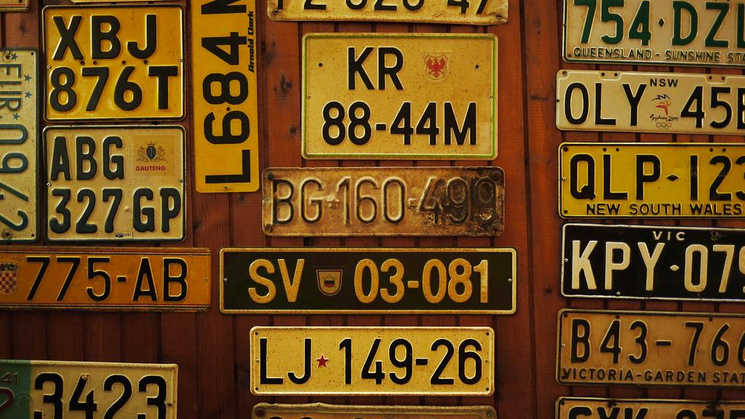
METHODOLOGY
Our license plate detection system works like this: Firstly, we set up a virtual environment in Jupyter Notebook. Then, we collected license plate data from Kaggle to use as our training material. Next, we trained our system using TensorFlow, which is like the brain that helps our computer recognize license plates. We also set up TensorFlow APIs to work with our dataset.
To make sure our system knows what a license plate looks like, we used a label map. This map lists all the things the model can detect, but we focused on training it specifically for license plates. We went through more than 10,000 steps to train our dataset because the more steps we take, the more accurate our system becomes at recognizing license plates.
After training, we tested our system by importing an image to see how much of the license plate it could detect. The results were shown as a percentage, indicating how well our system identified the license plate.

Slide 5
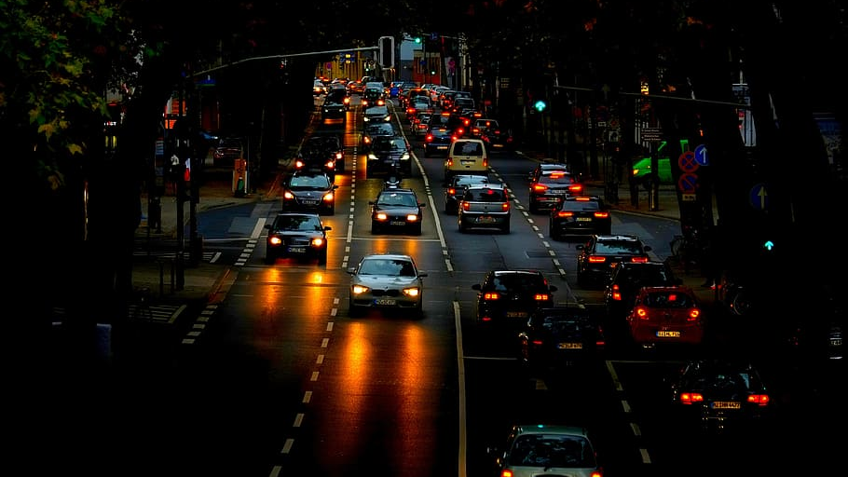
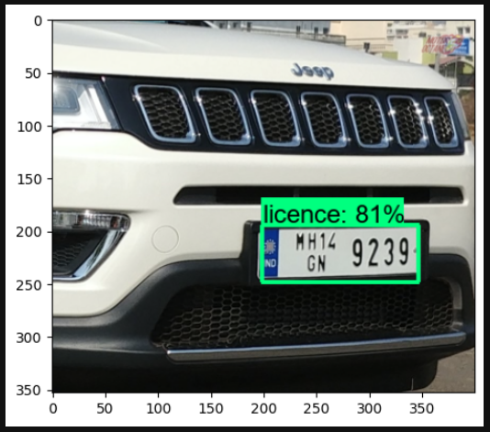
Result
Our number plate detection and recognition system using Python worked well! After setting up everything and training our system with a lot of examples, we tested it on images. It successfully identified and recognized license plates. We can now use this technology for various purposes, like making toll collection smoother or helping law enforcement. It's like giving our computer the ability to "see" license plates and understand the information on them.

Slide 6
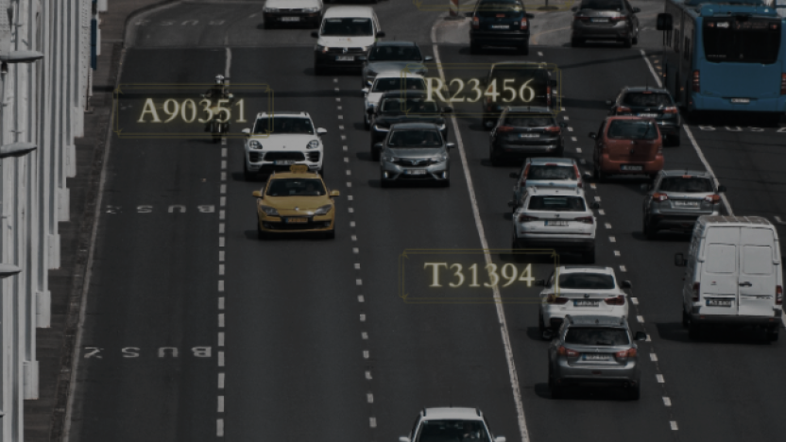
CONCLUSION AND FUTURE WORK
In conclusion, our number plate detection and recognition system using Python has shown promising results. By leveraging computer vision, we've enabled computers to identify license plates accurately. The system has potential applications in various fields, including transportation, law enforcement, and security systems. With continued efforts in research and development, we can enhance the system's capabilities, making it a valuable tool for improving efficiency in different domains.
For our number plate detection and recognition project using Python, there are exciting possibilities for future improvements. We can explore more advanced algorithms and techniques to make the system even more accurate and efficient. Additionally, incorporating real-time processing capabilities can enhance the system's performance, making it quicker and more responsive. We can focus on varying lighting conditions and different plate styles.

